Slide 1

we are “The 7 A.I.”
Project 1.4 Final Approach

Slide 2
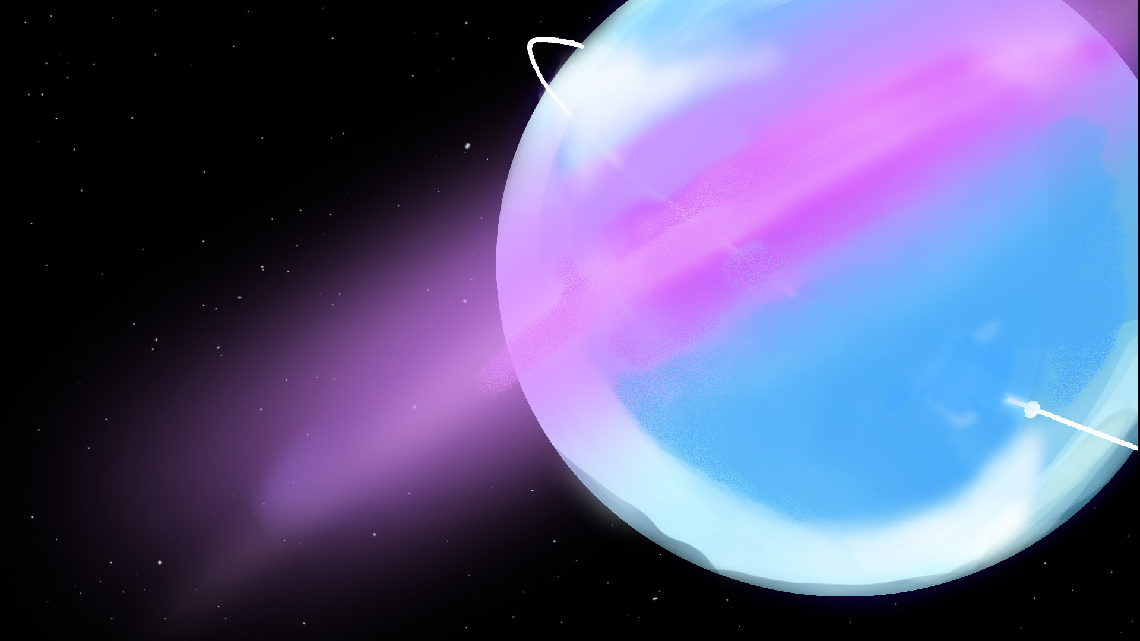

Agenda
The Game
Meet The Team
Game Concepts
Concept Art
Sound Design
Physic & Game Mechanics Implementation
Testing
Hours & Tasks Planning
Reflection

Slide 3


Slide 4
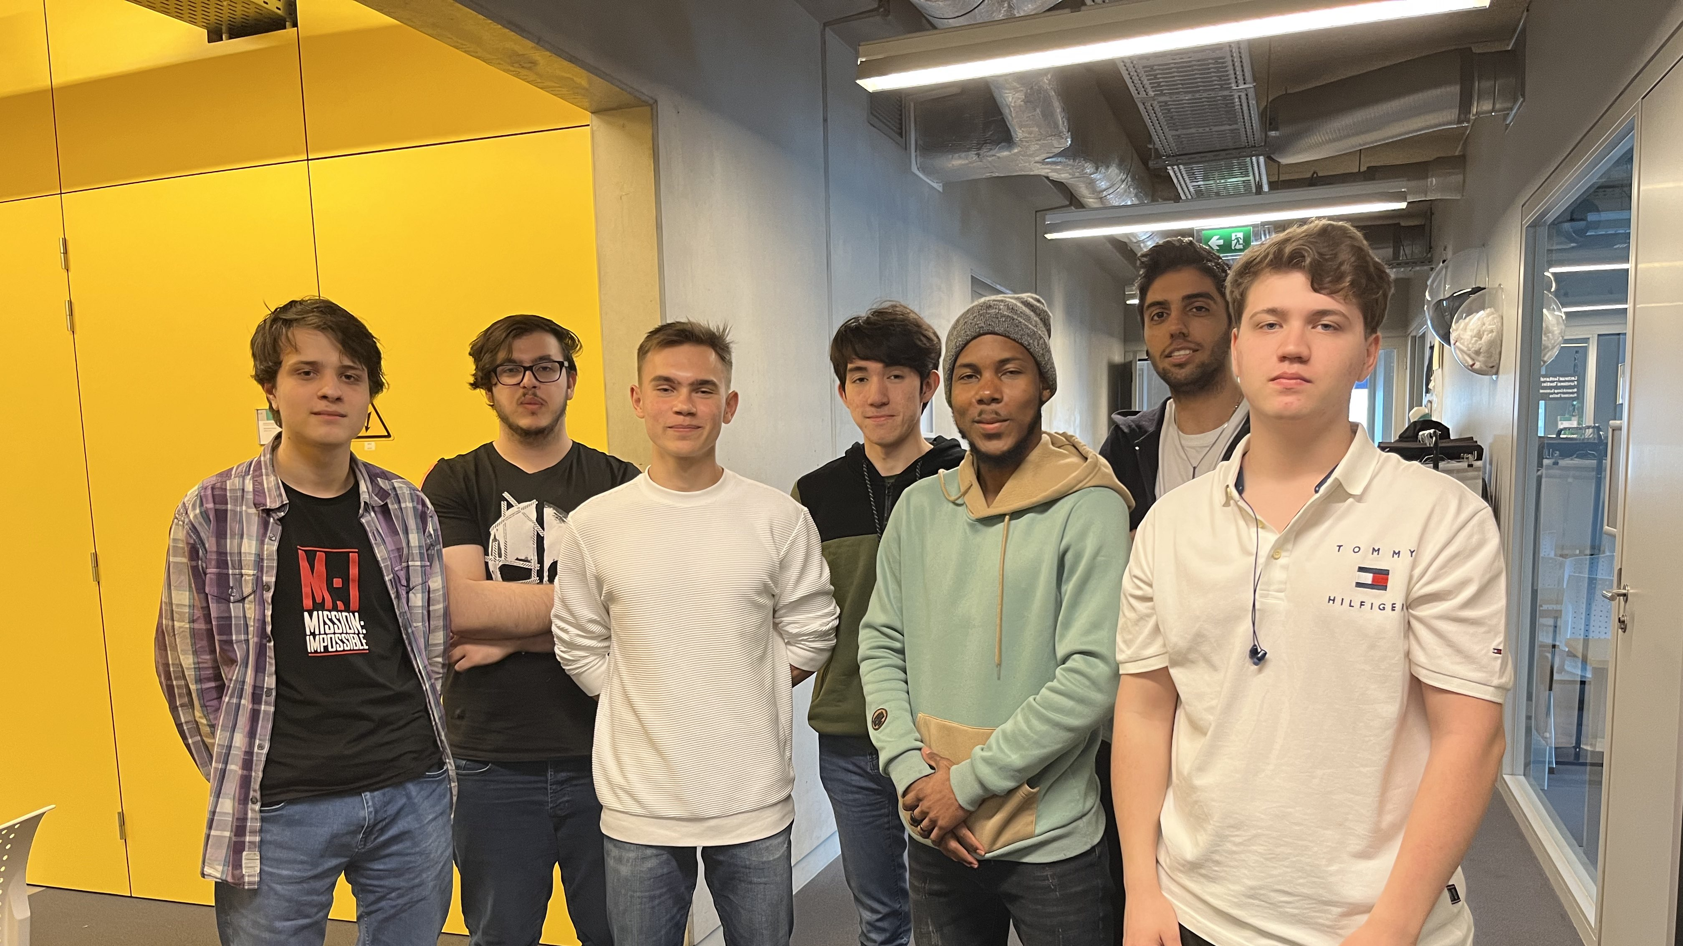
Meet The Team
Artists:
Filipp: Project Manager, UI Art, Character Textures, Tileset Art
Aref: Background Art, Tileset art and Animations
Darren: 3D Character Design; Art & Animation
Designers:
Lev (Designer): Game mechanics & rules, Level design
Alexander (Designer): Sound Design, Music, UI Design, Story, Assets checklist
Engineers:
Nikola: Physics, implementing player movement & game mechanics, Sound implementation
Antonio: Physics, implementing player movement & game mechanics

Slide 5
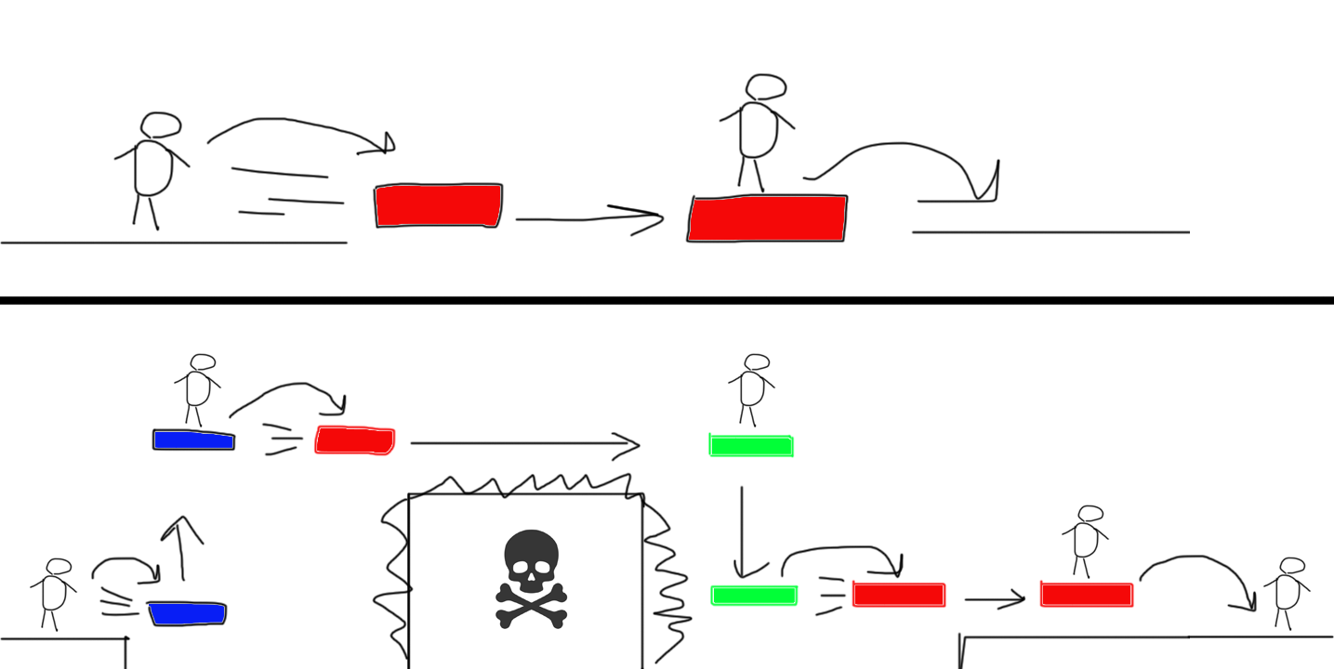
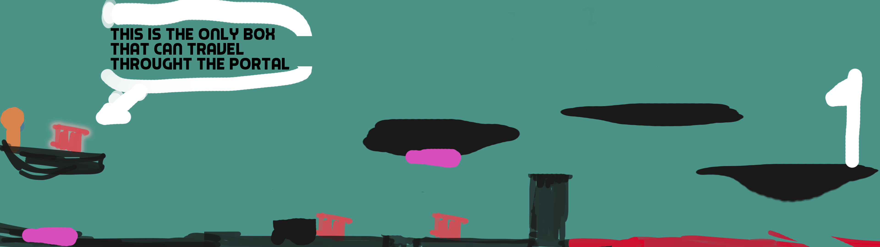
Game concepts (1)
Sketches
Discussing game mechanics

Slide 6
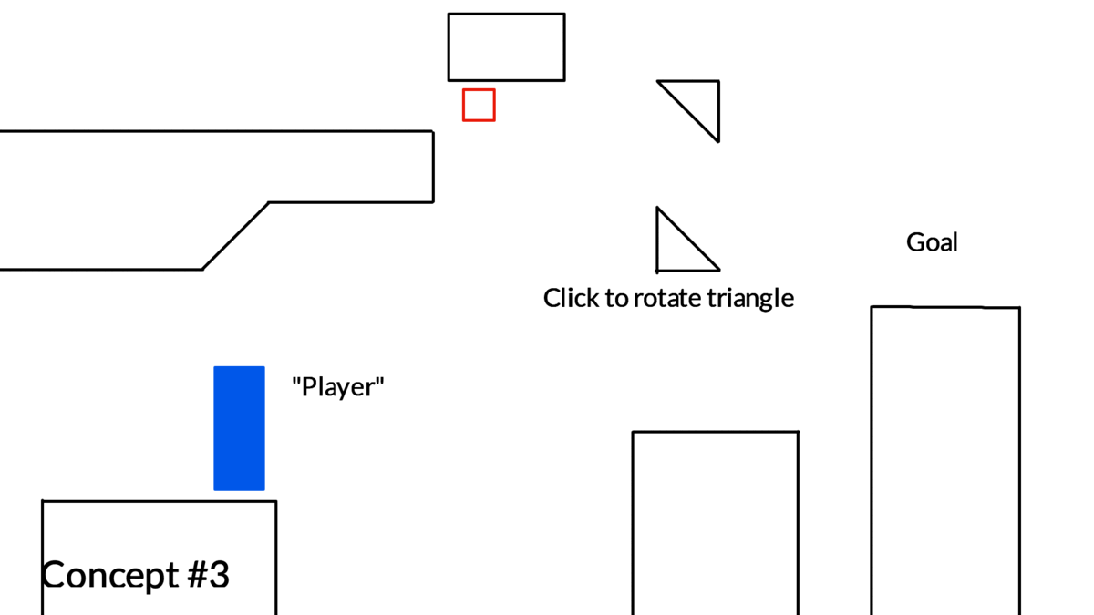
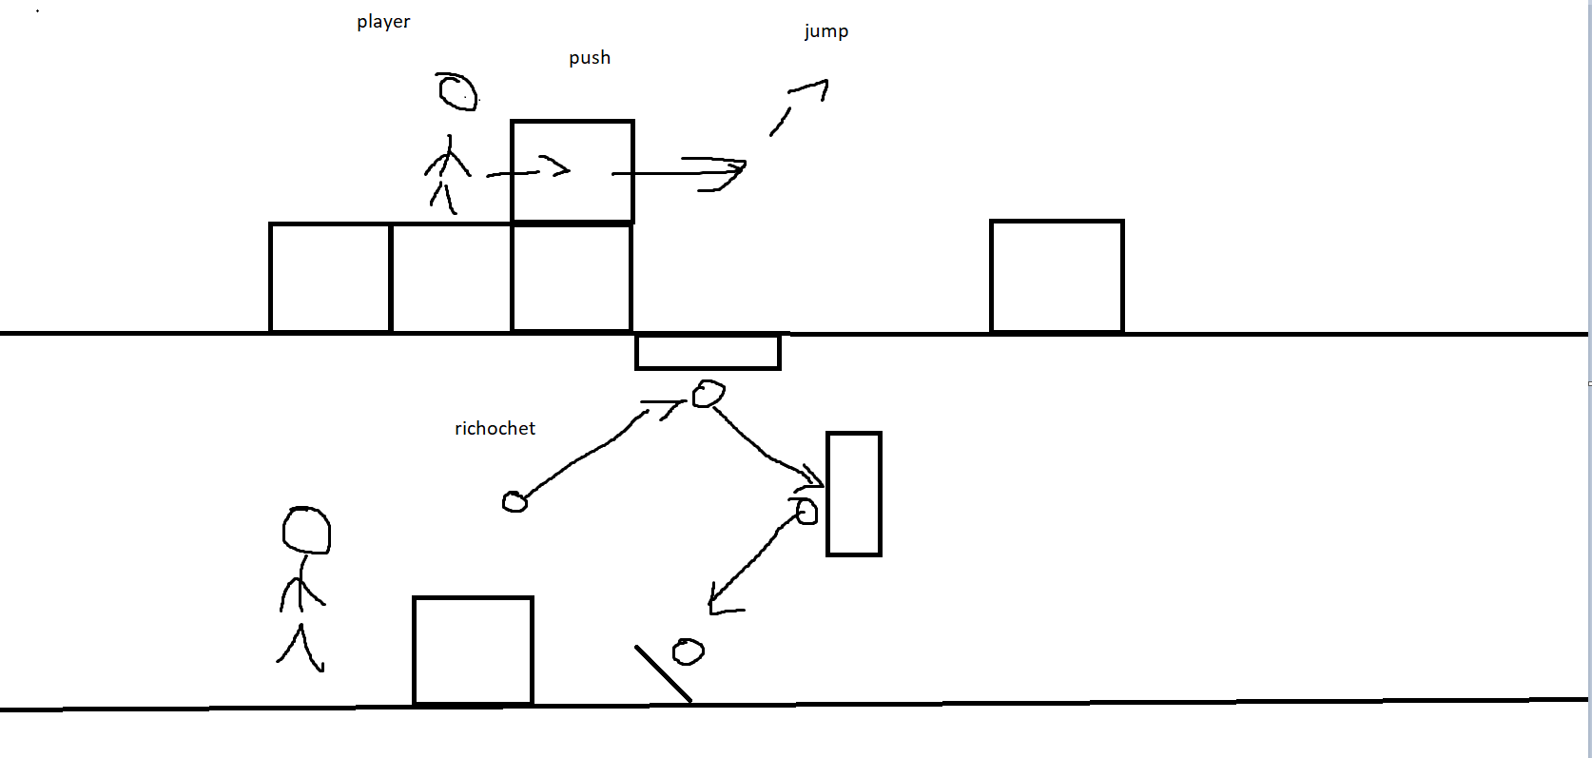
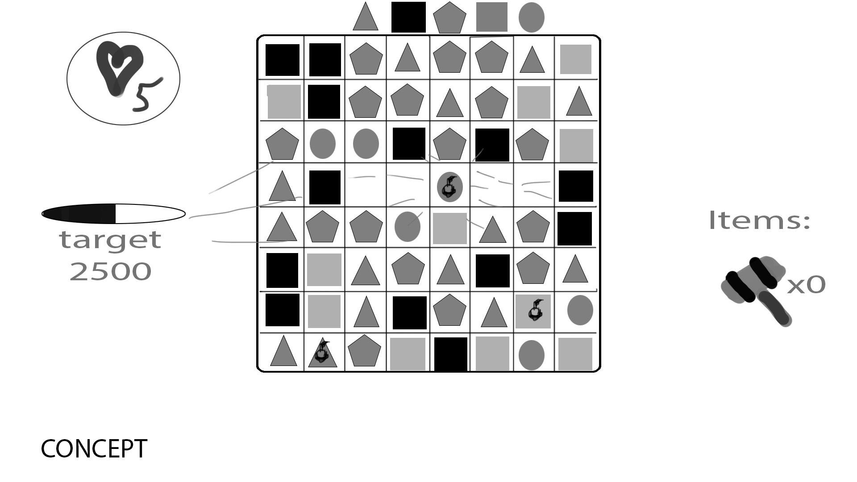
Game concepts (2)
Sketches

Slide 7
Game concepts (3)
Sketches

Slide 8
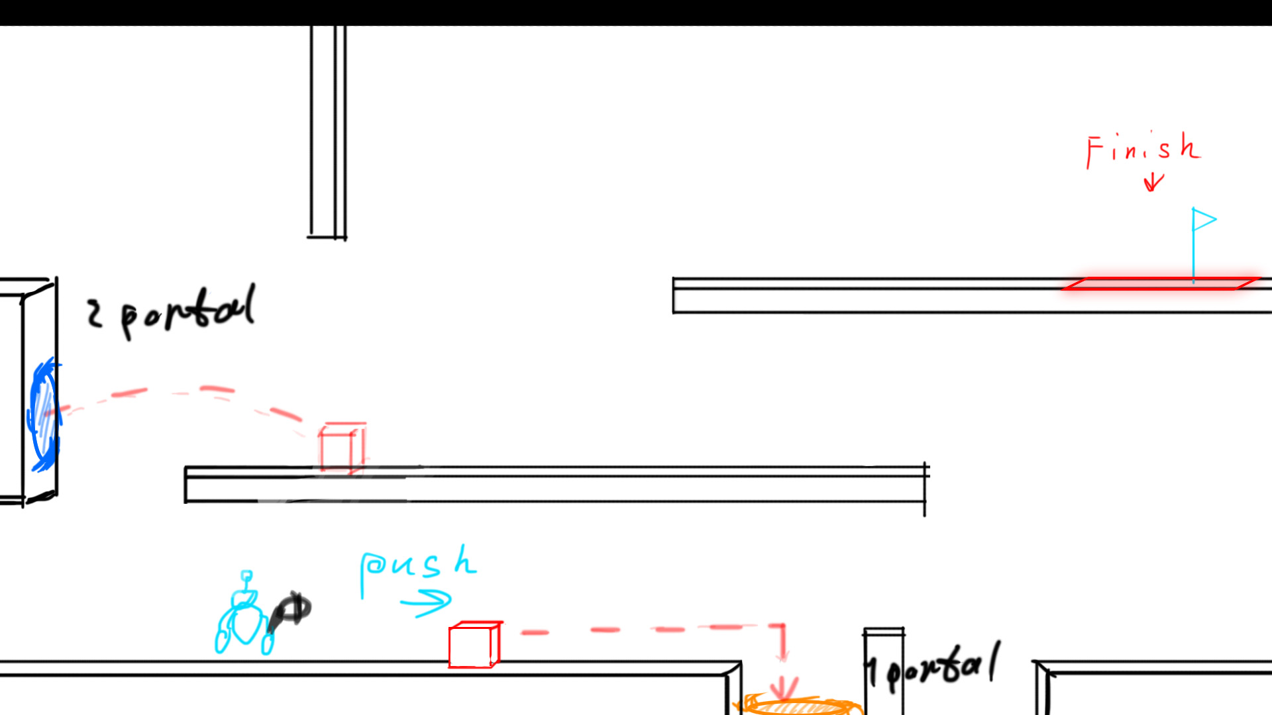
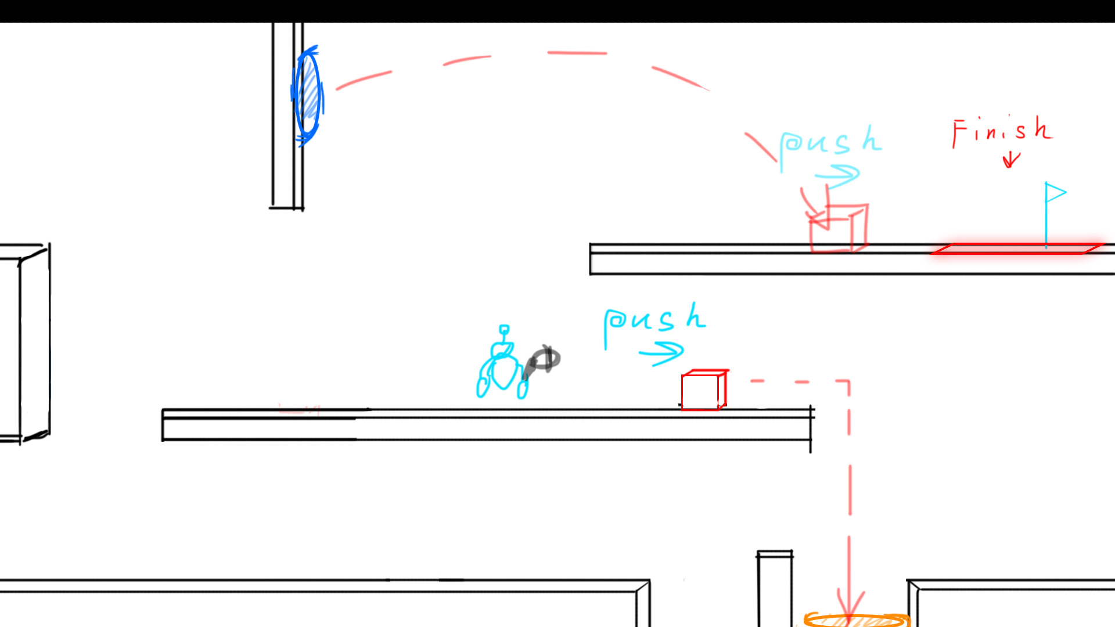
Game concepts (4)
Final concept sketch

Slide 9
Story
Somewhere in space, a spaceship has collided with a big asteroid, and now the spaceship is heavily damaged! The engines have stopped working, and a big part of the internal structure of the ship is broken too. The crew that used to be on the spaceship, has already evacuated with tiny emergency spaceships.
However… they “forgot” someone. One robot. The crew left a robot behind on the spaceship... He got betrayed by his crew! How could they leave him behind like that? He’s now stuck on this spaceship… and if he doesn’t escape the spaceship, he will die! But… there seems to be no way out… At this rate, he won’t make it out alive… If he wants to live, he must do something! There must be a way out, right?
And then suddenly, he realizes something... He has his portal gun! His crew never allowed him to use his portal gun before, but since his crew betrayed him, he doesn’t have to obey those orders anymore.
He doesn’t really have a choice anyway. If he wants to have a chance to survive, he must use his portal gun, it’s his only option left! However, escaping the spaceship still is a challenging task. Since the ship is heavily damaged, parts of the ships are broken. And that’s not the only thing, there are also obstacles in the way that our robot must traverse through. If he uses his portal gun in creative ways, he might be able to navigate through the spaceship.
Sadly, escaping the spaceship isn’t the only thing he has to worry about… To escape the spaceship, our robot needs to open a gate. To open this gate, he needs a battery. Along the way, there are battery fragments he needs to collect. Without these, he cannot open the gate.
With your help, he might be able to escape the spaceship and survive! Maybe not all hope is lost!

Slide 10
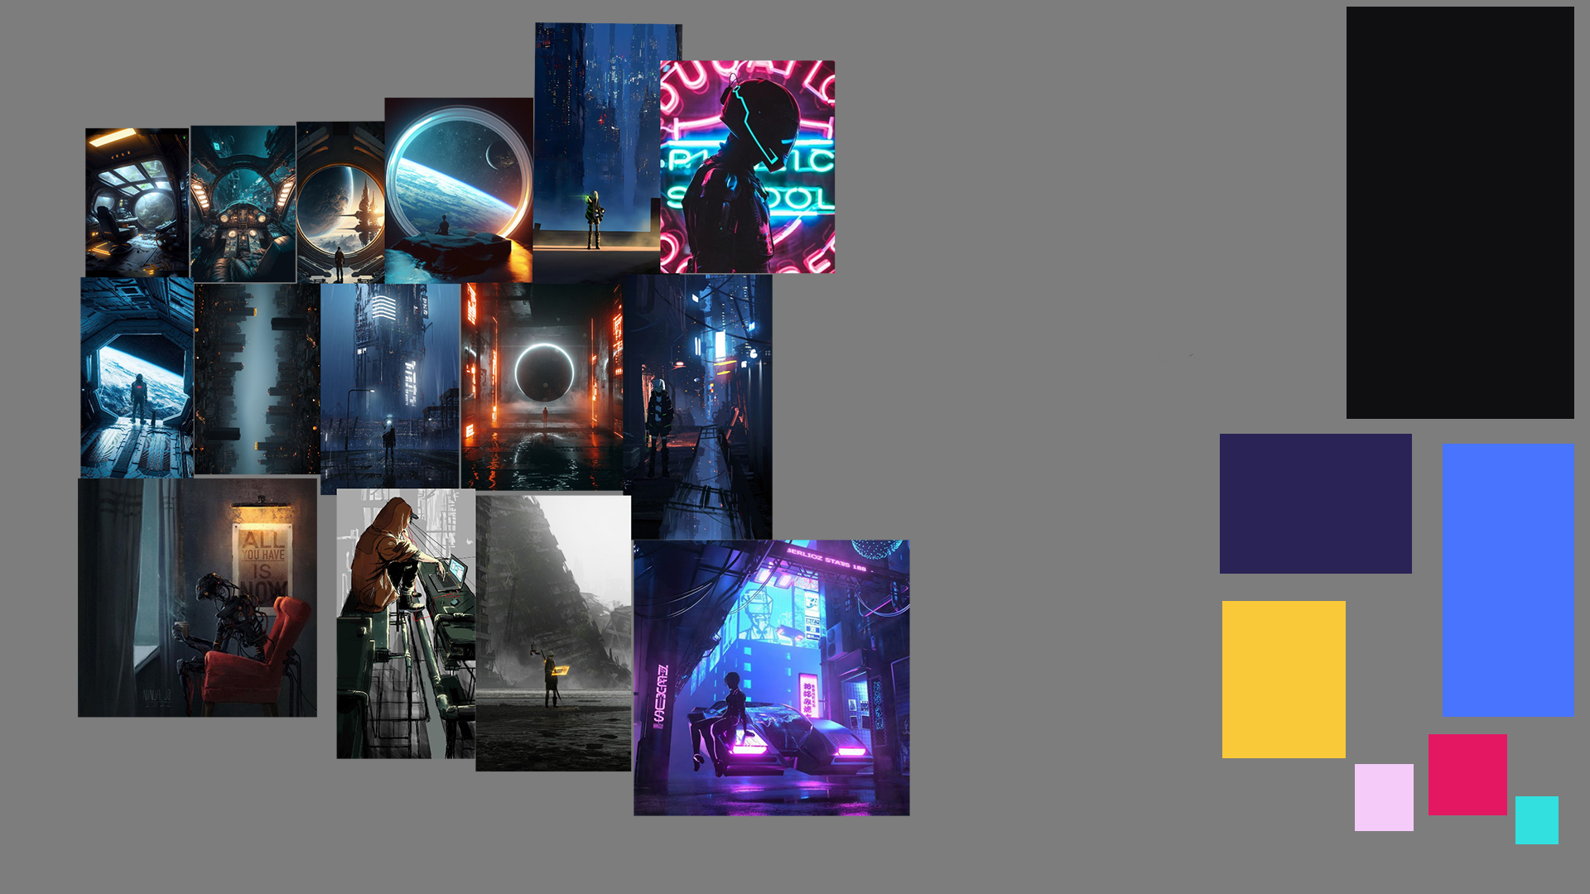
Mood board

Slide 11
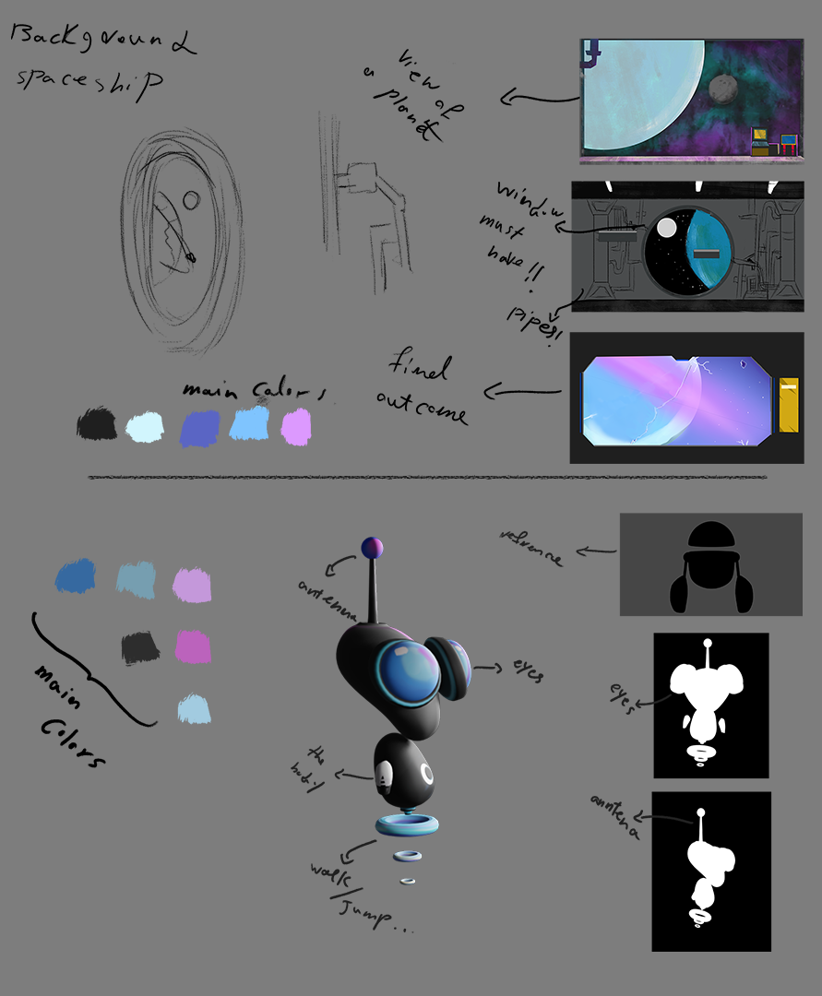
Style sheet

Slide 12



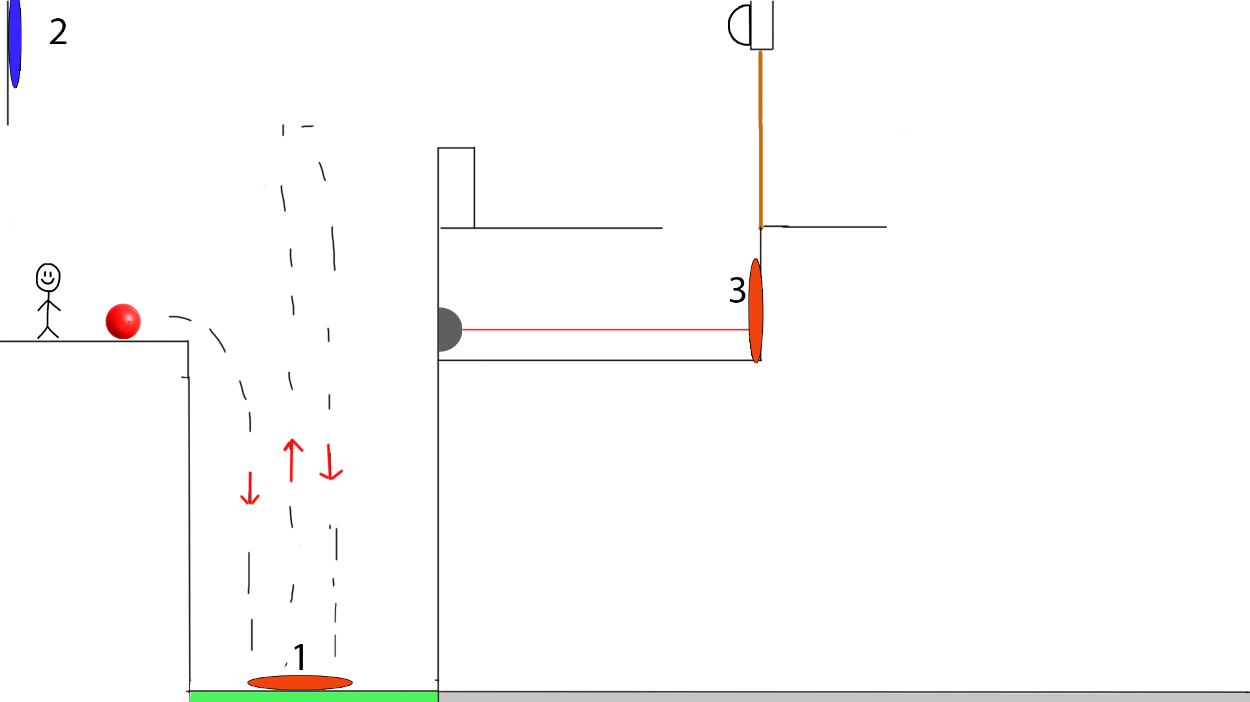
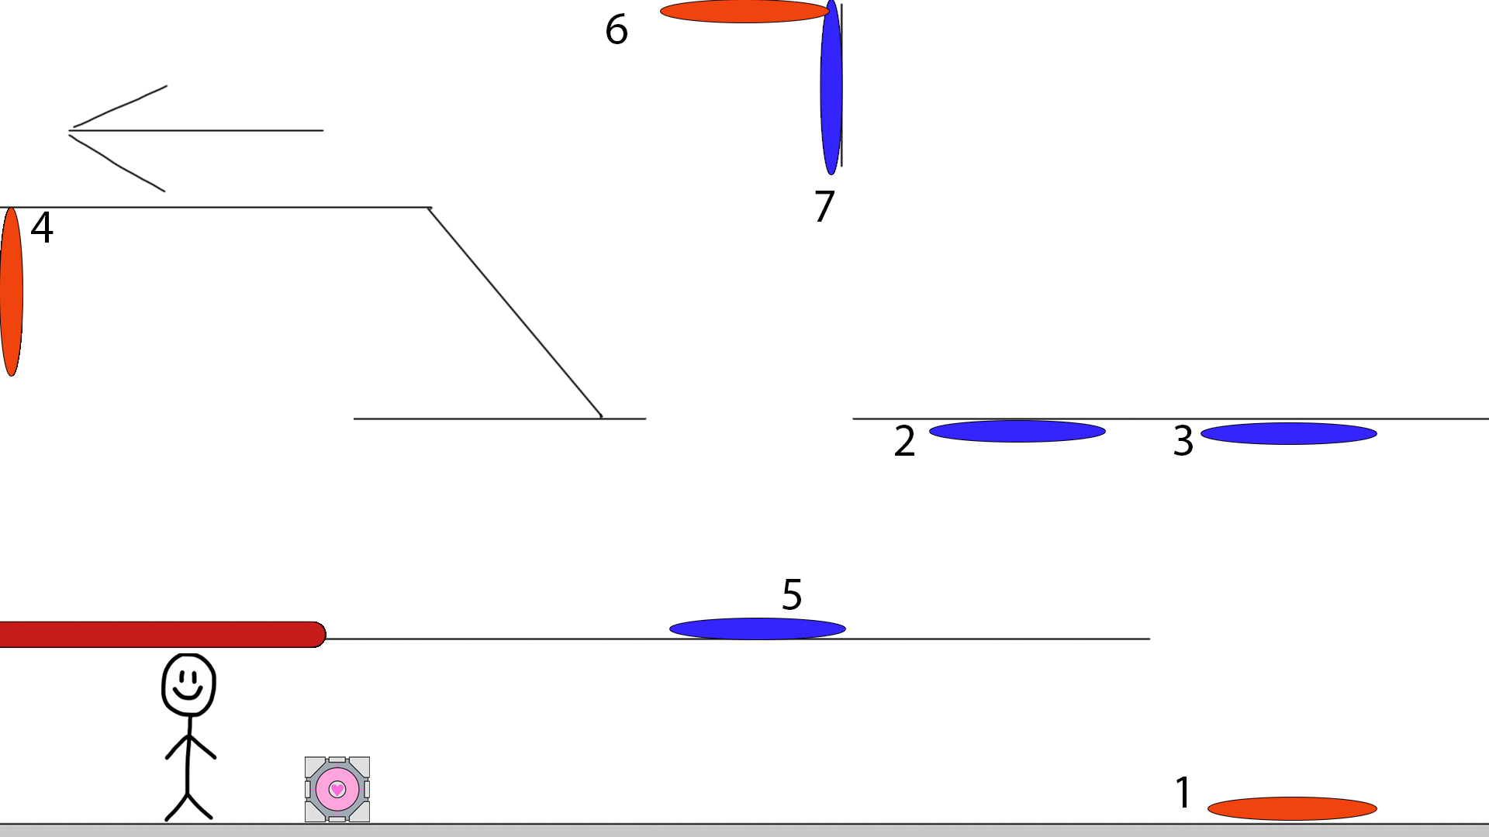
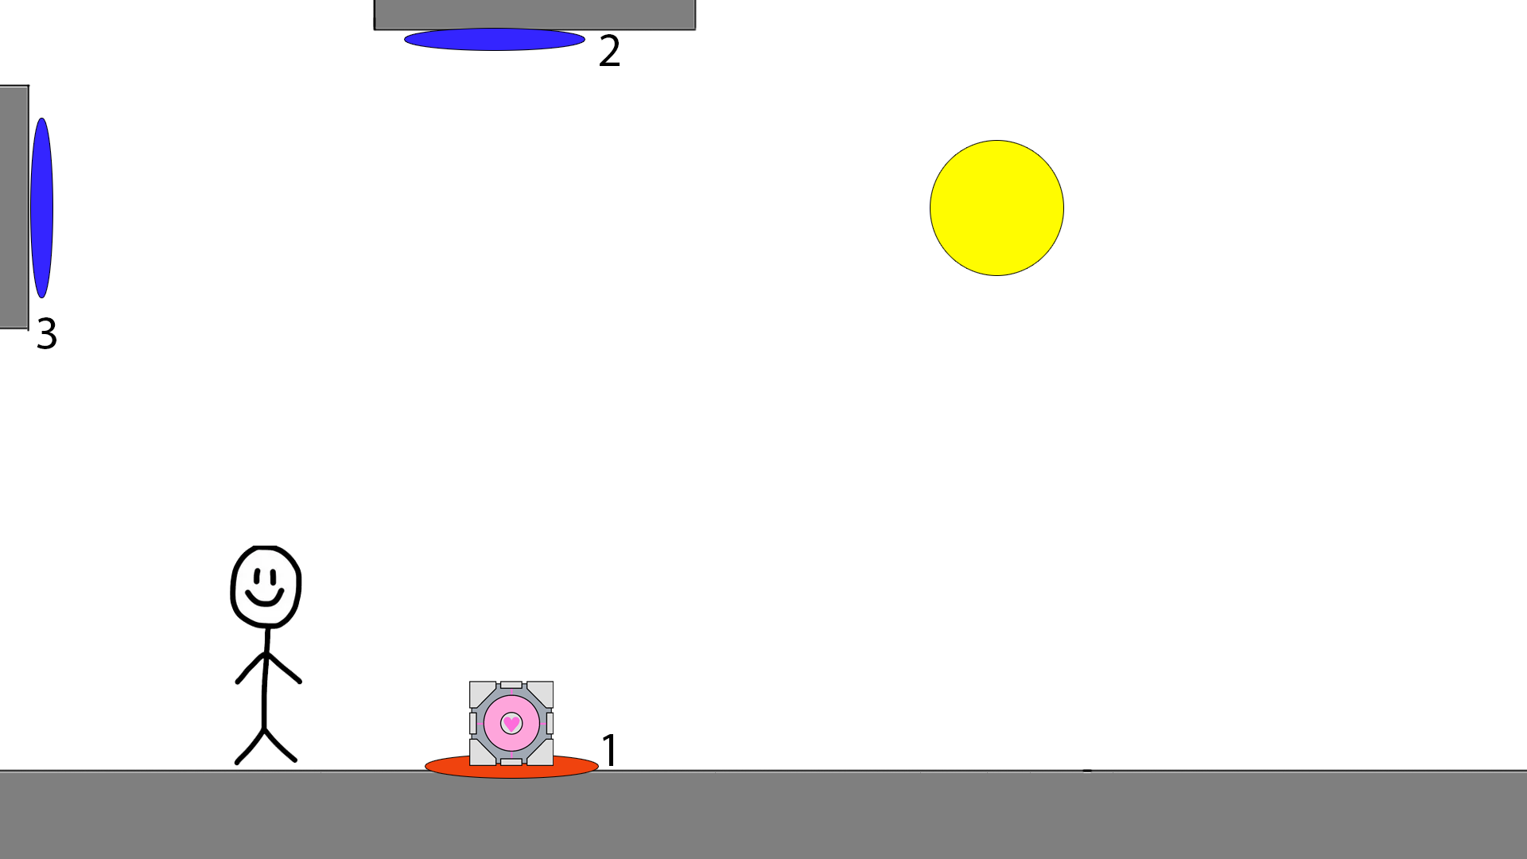
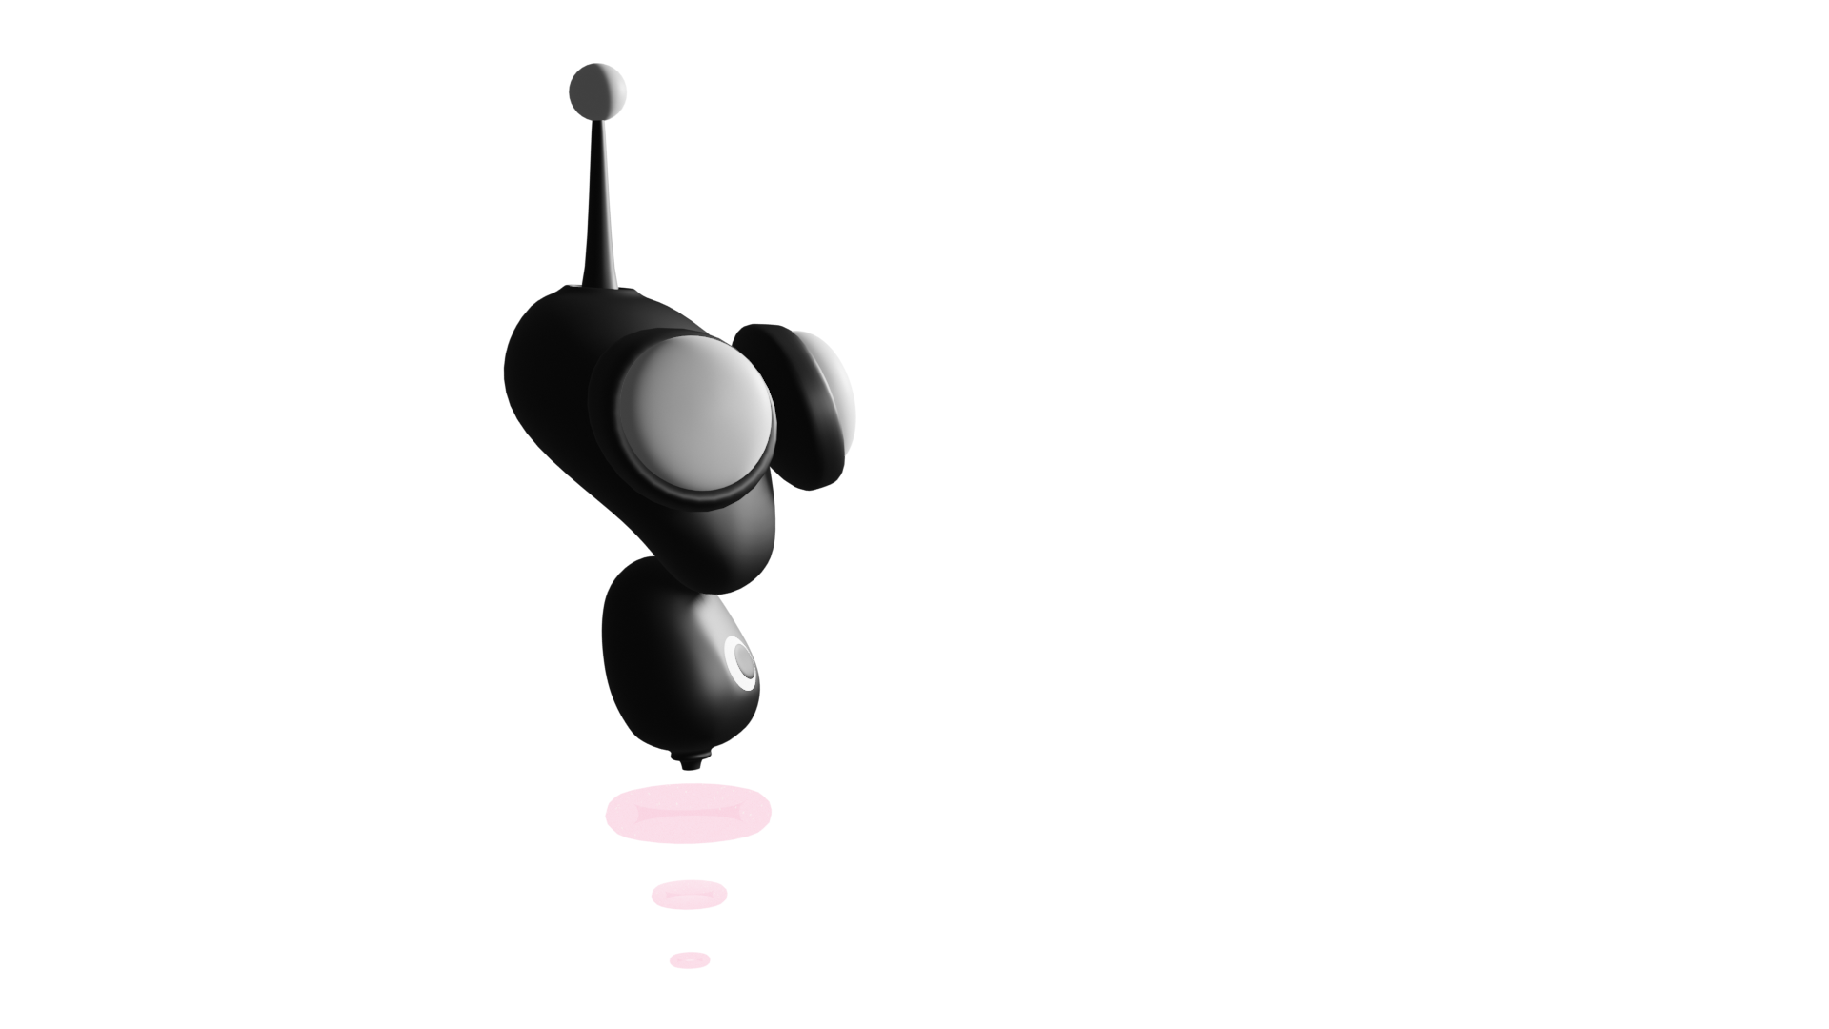
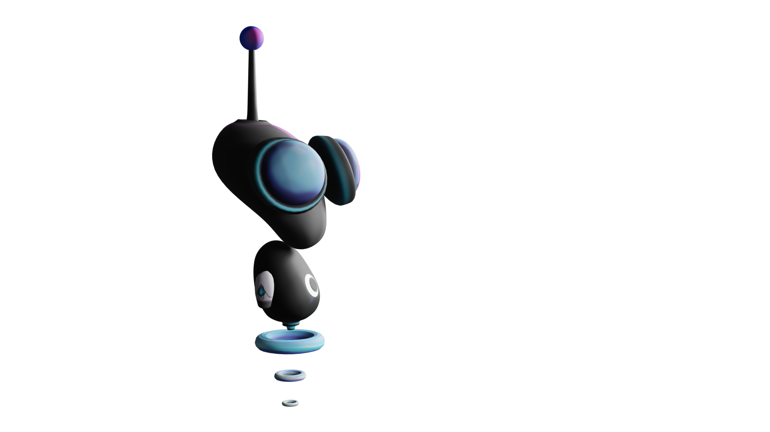
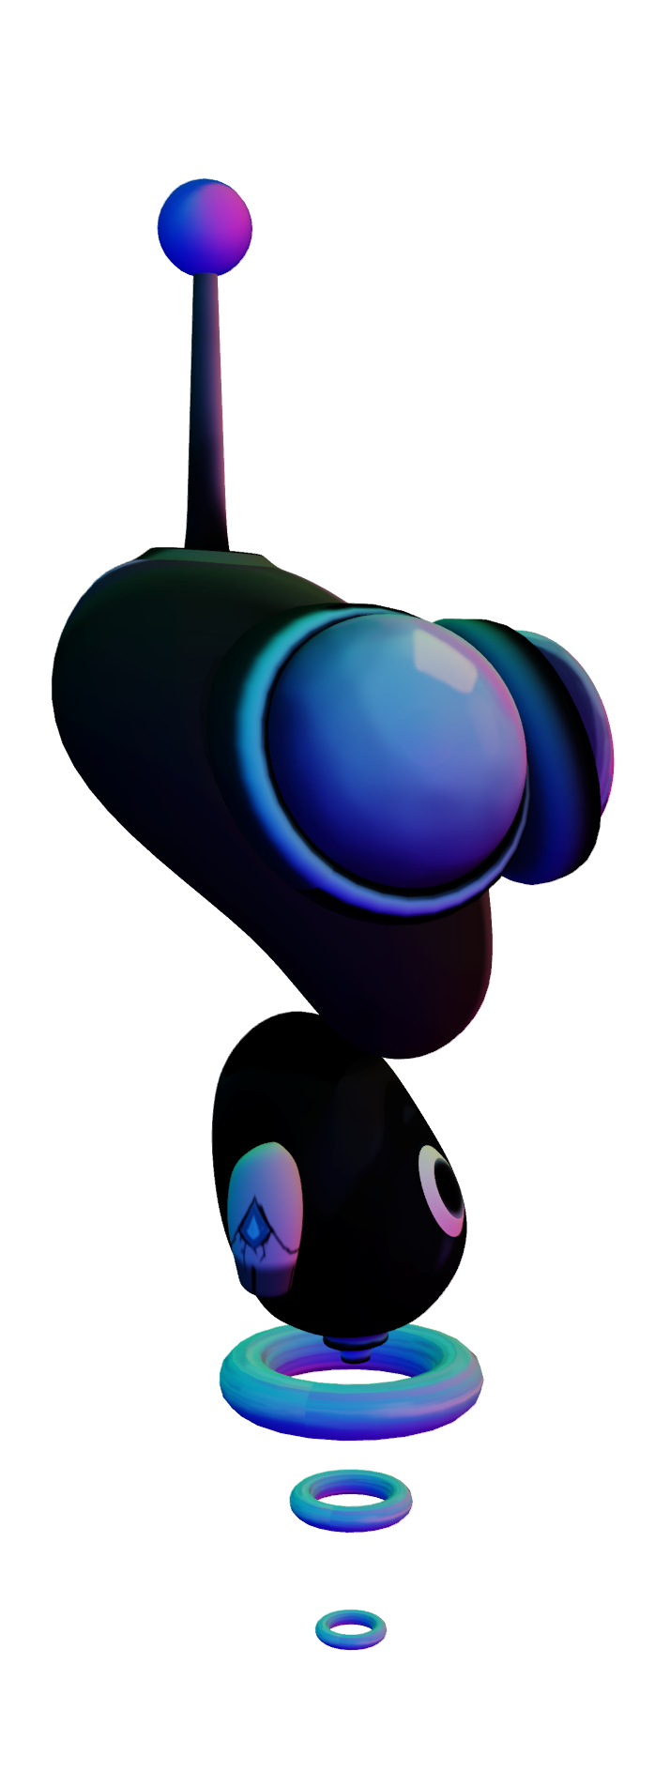

Concept art (1)
Level design concepts

Slide 13
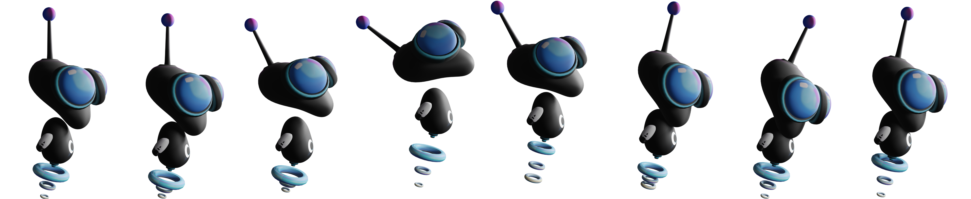
Concept art (2)
Character Designs

Slide 14
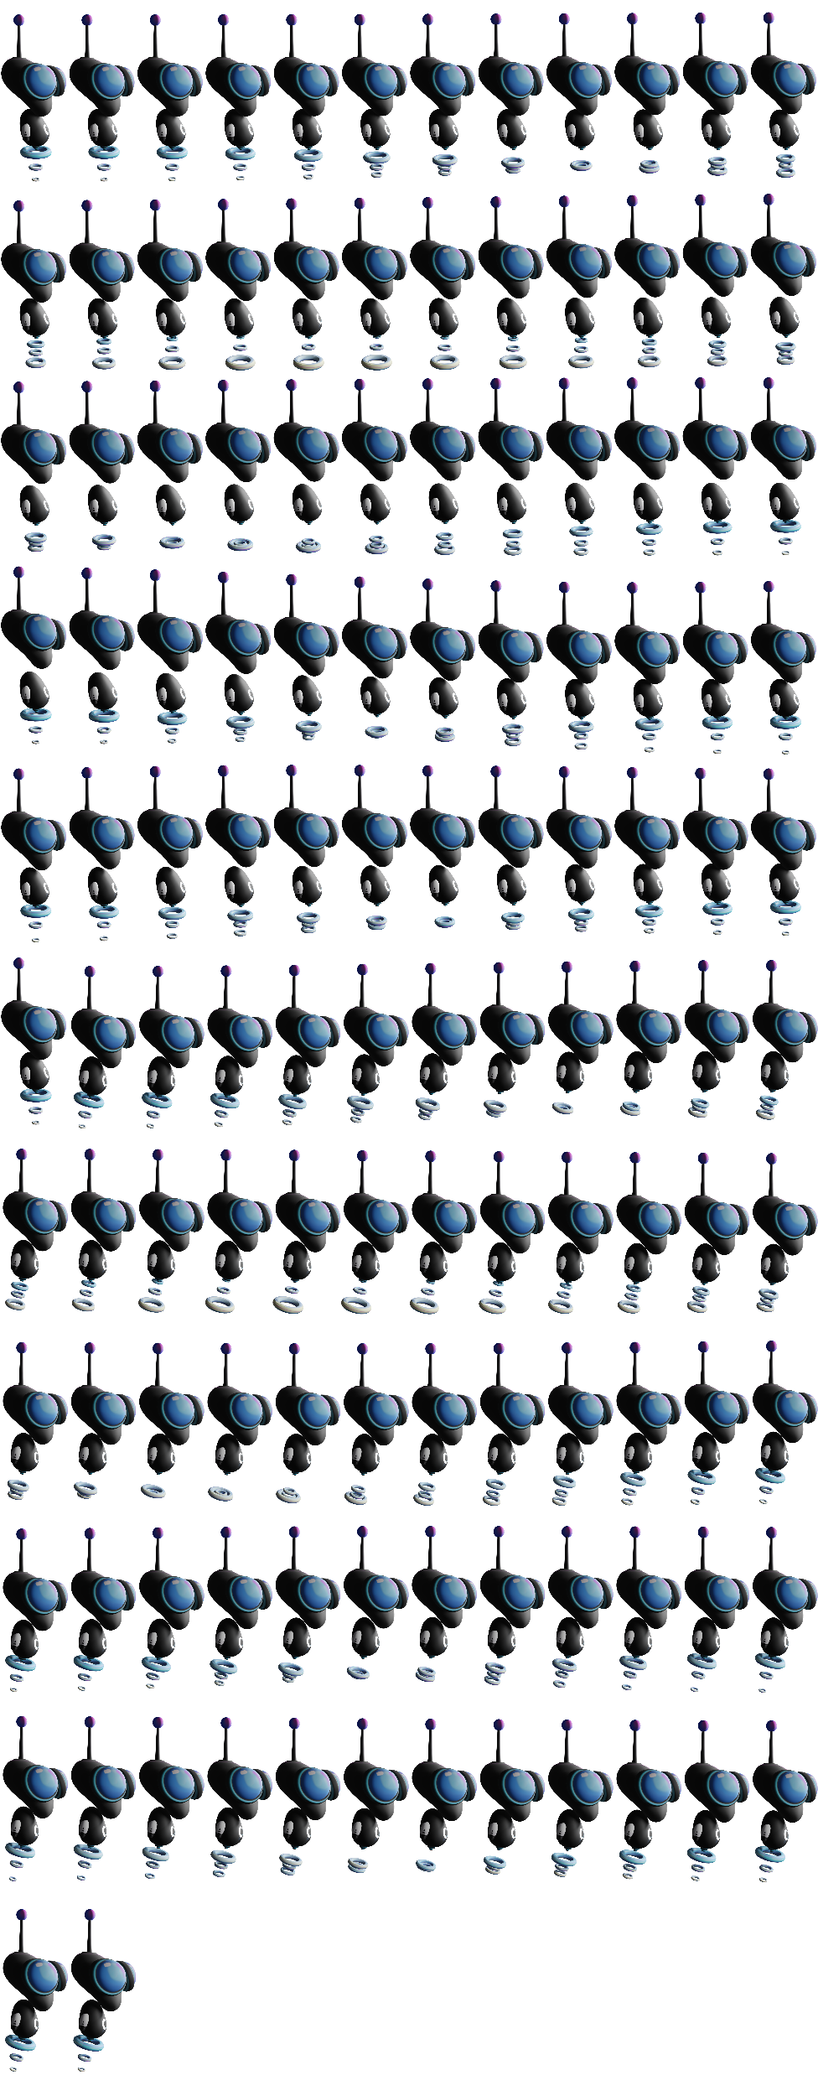
Concept art (3)
Character Designs

Slide 15
Concept art (2)
Character Designs

Slide 16
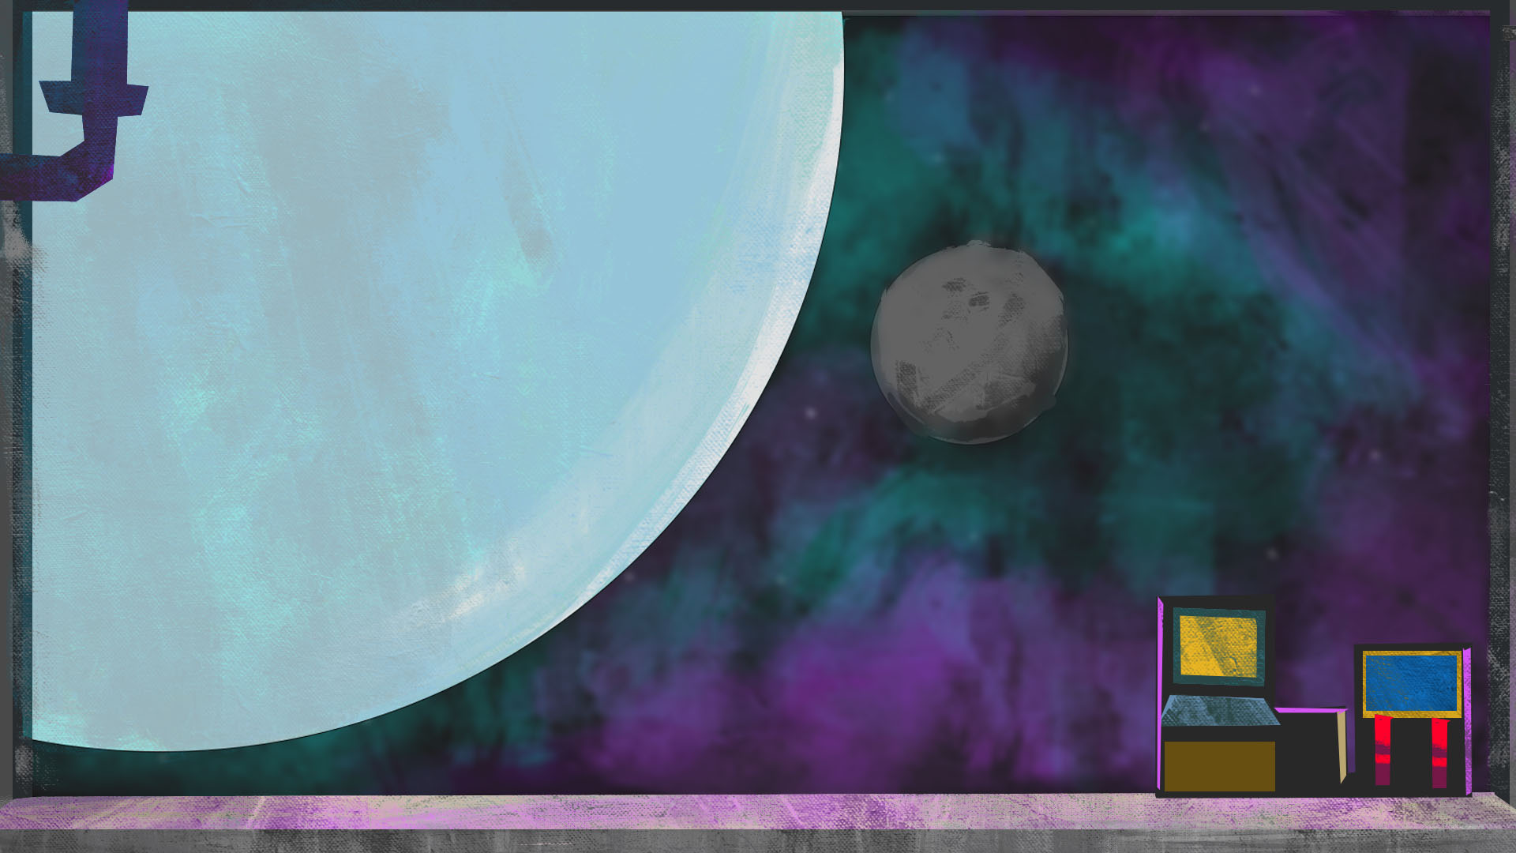
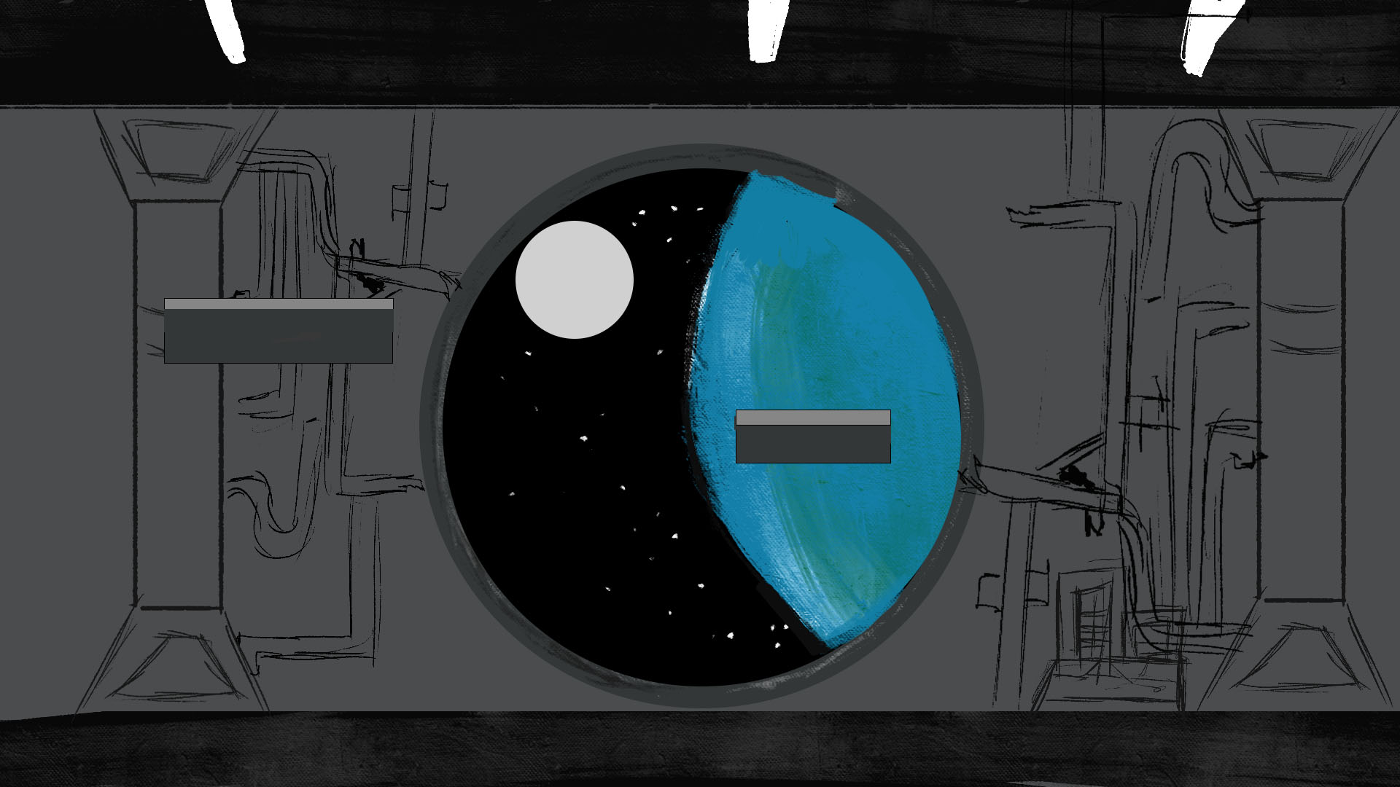
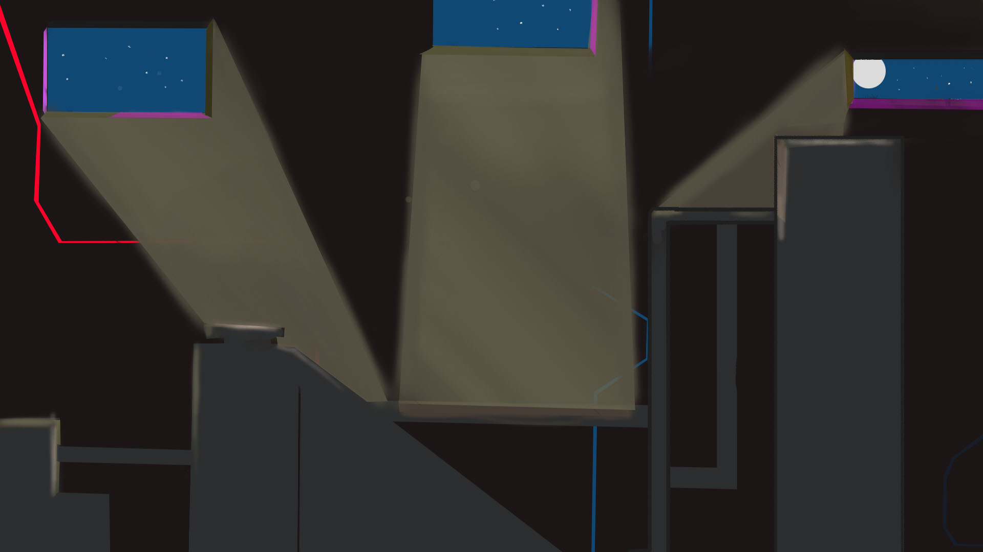
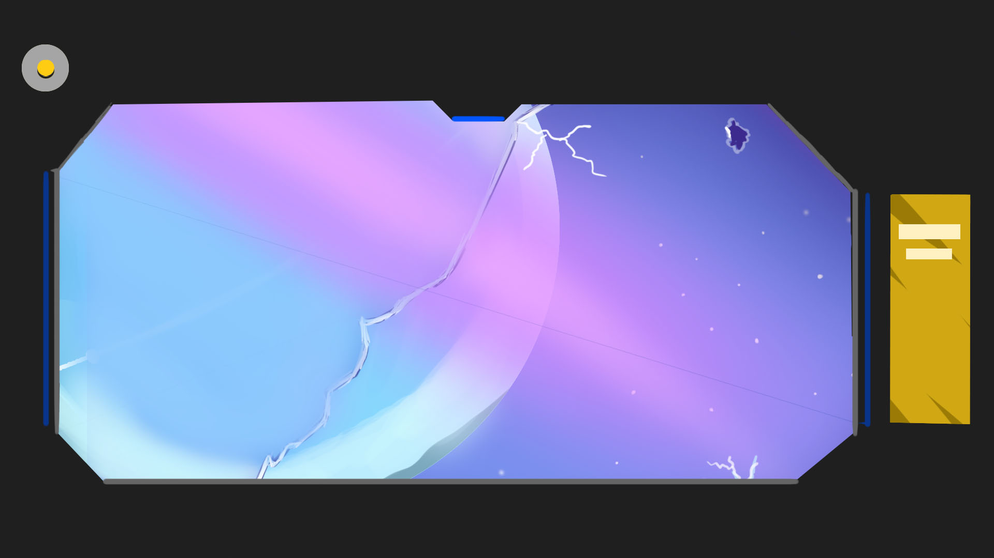
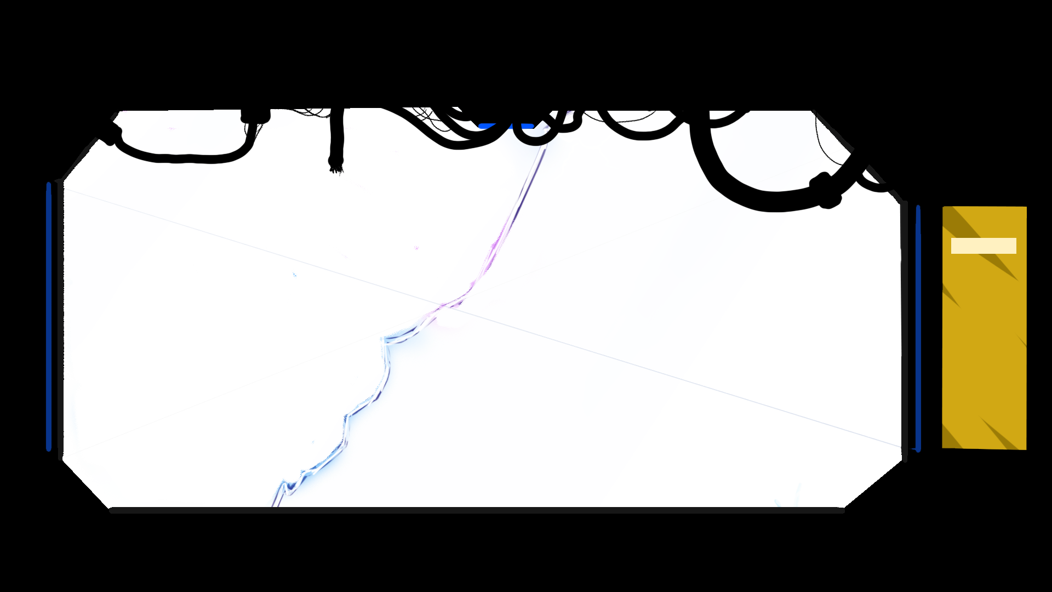
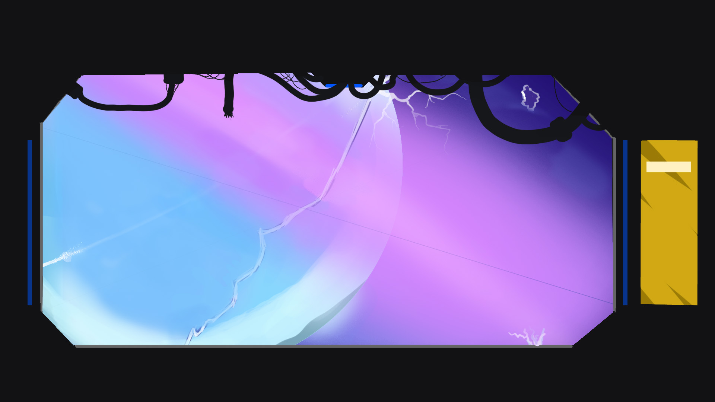
Concept art (3)
Backgrounds

Slide 17
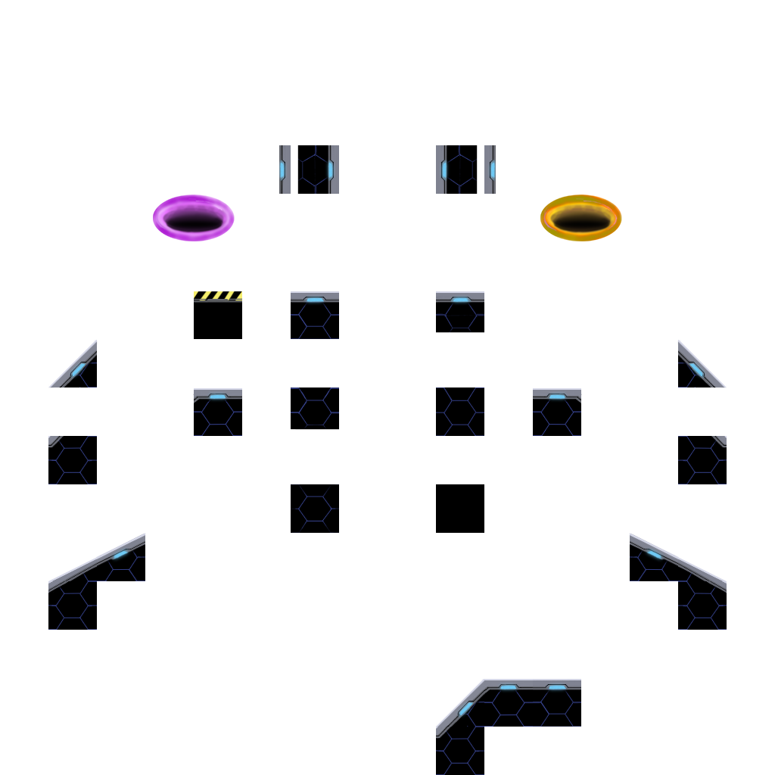
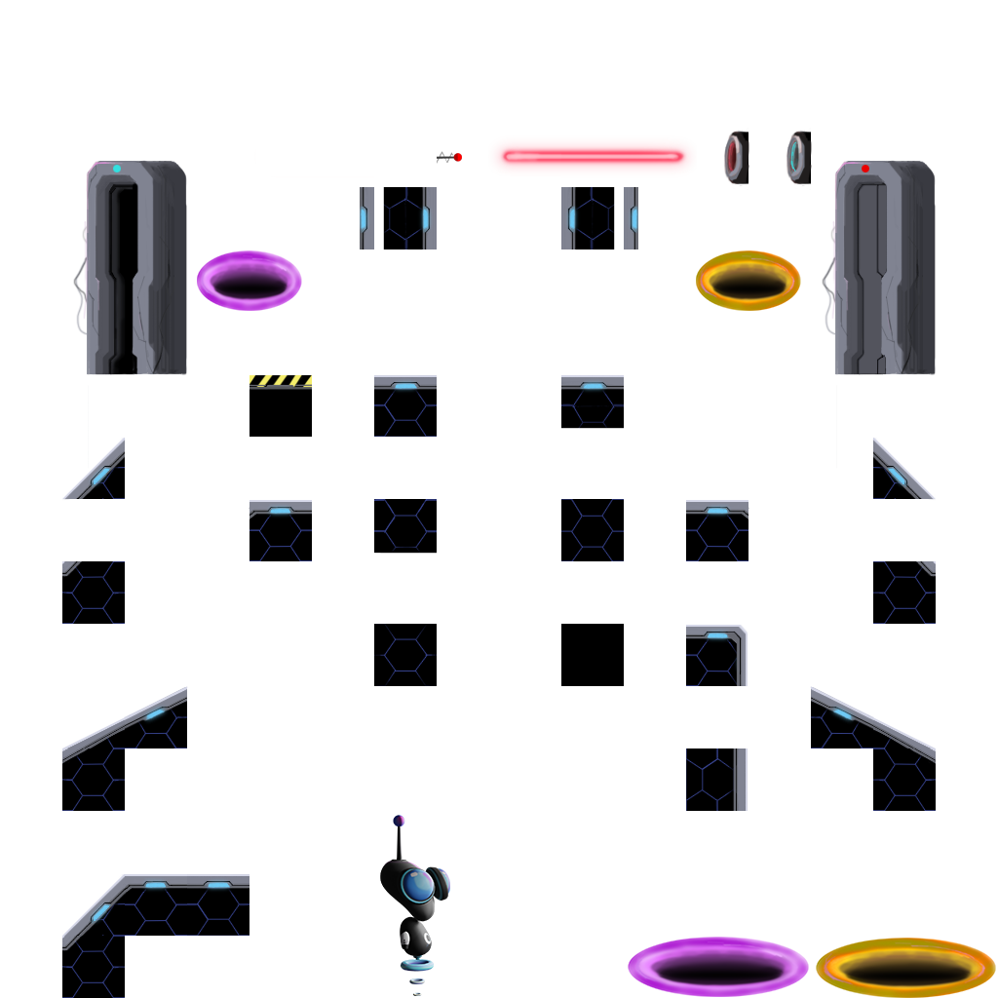
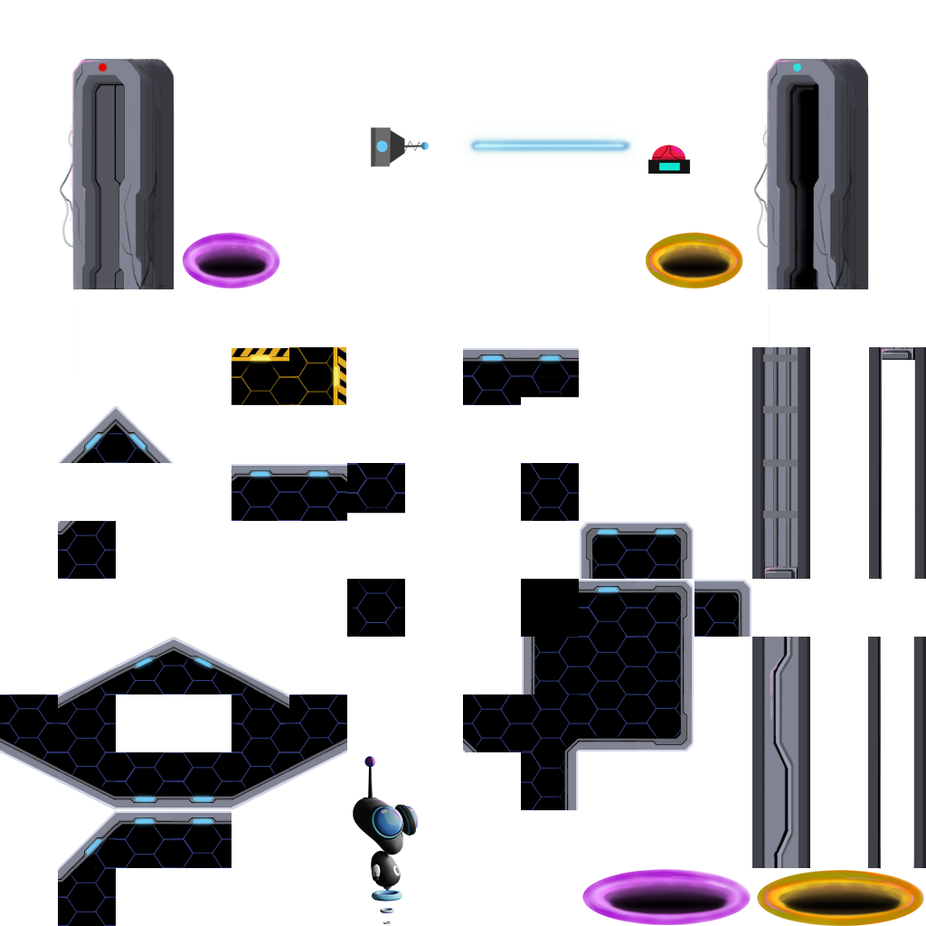
Concept art (5)
Tilesets

Slide 18
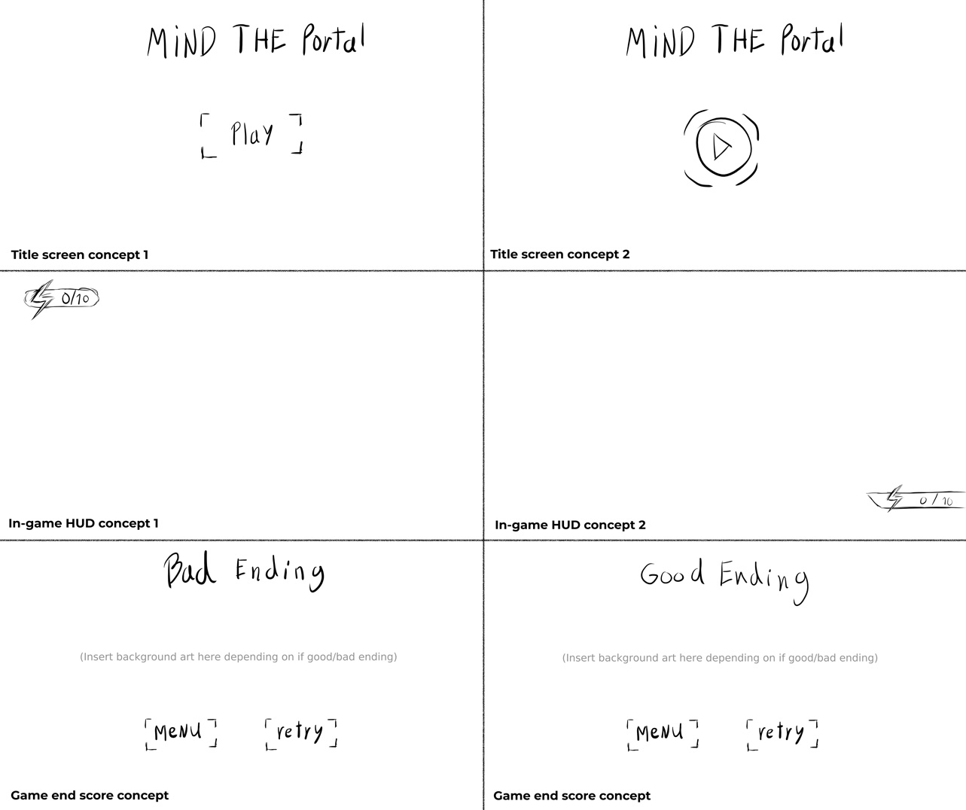
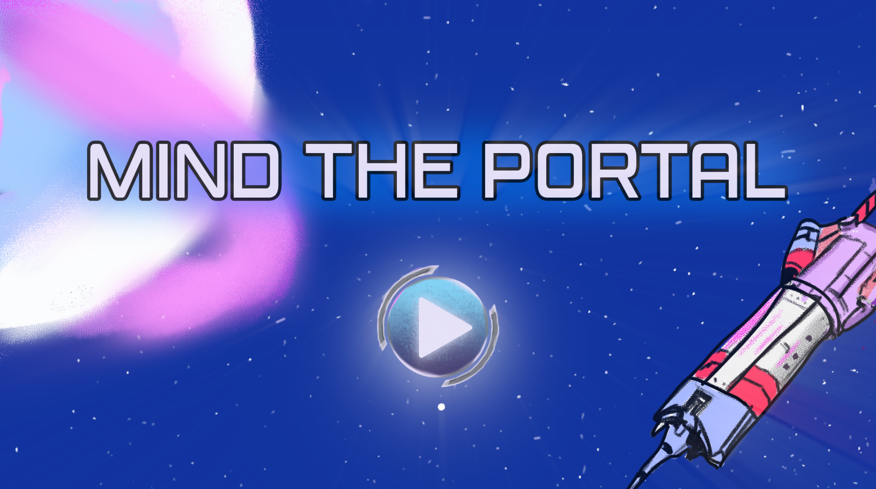
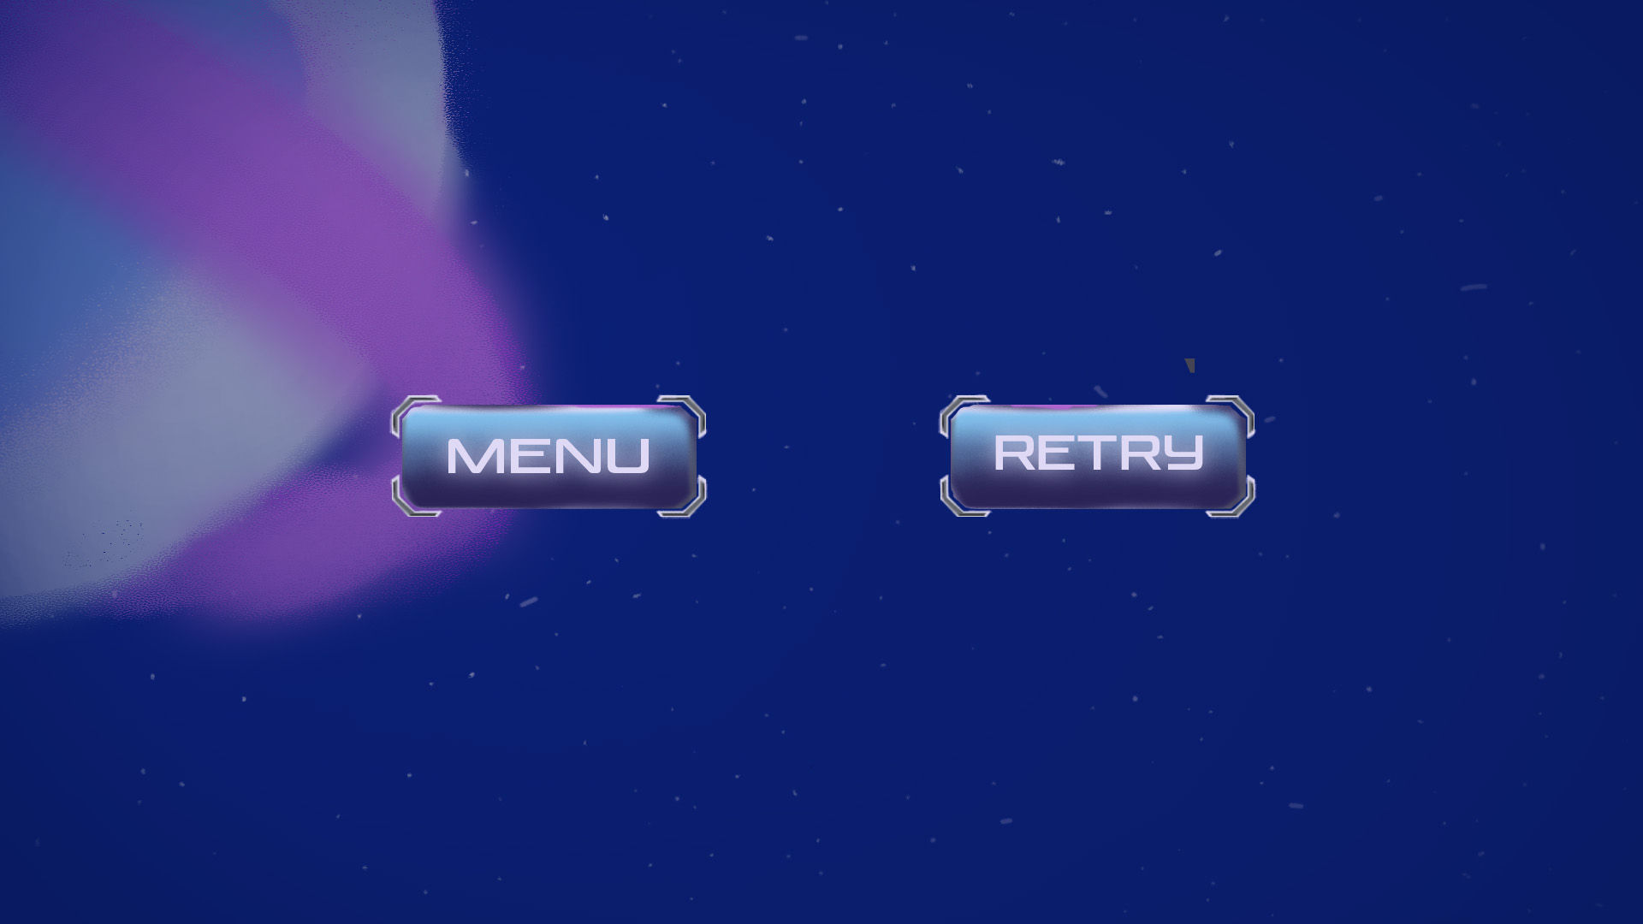
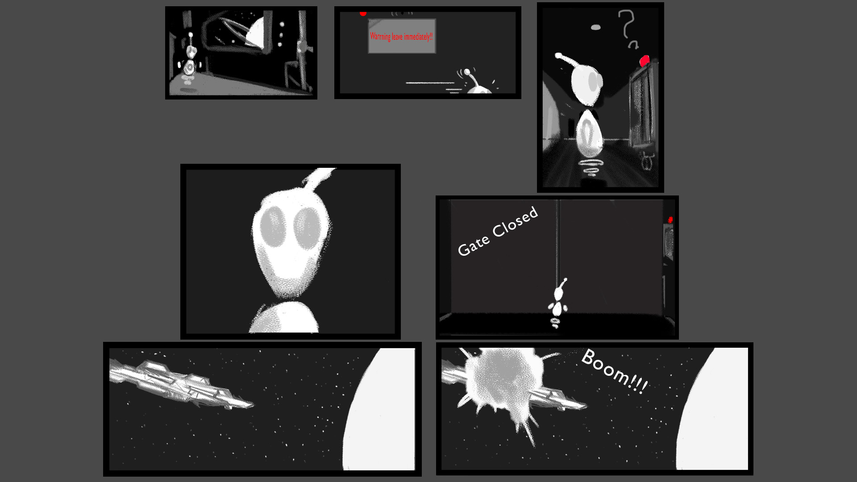
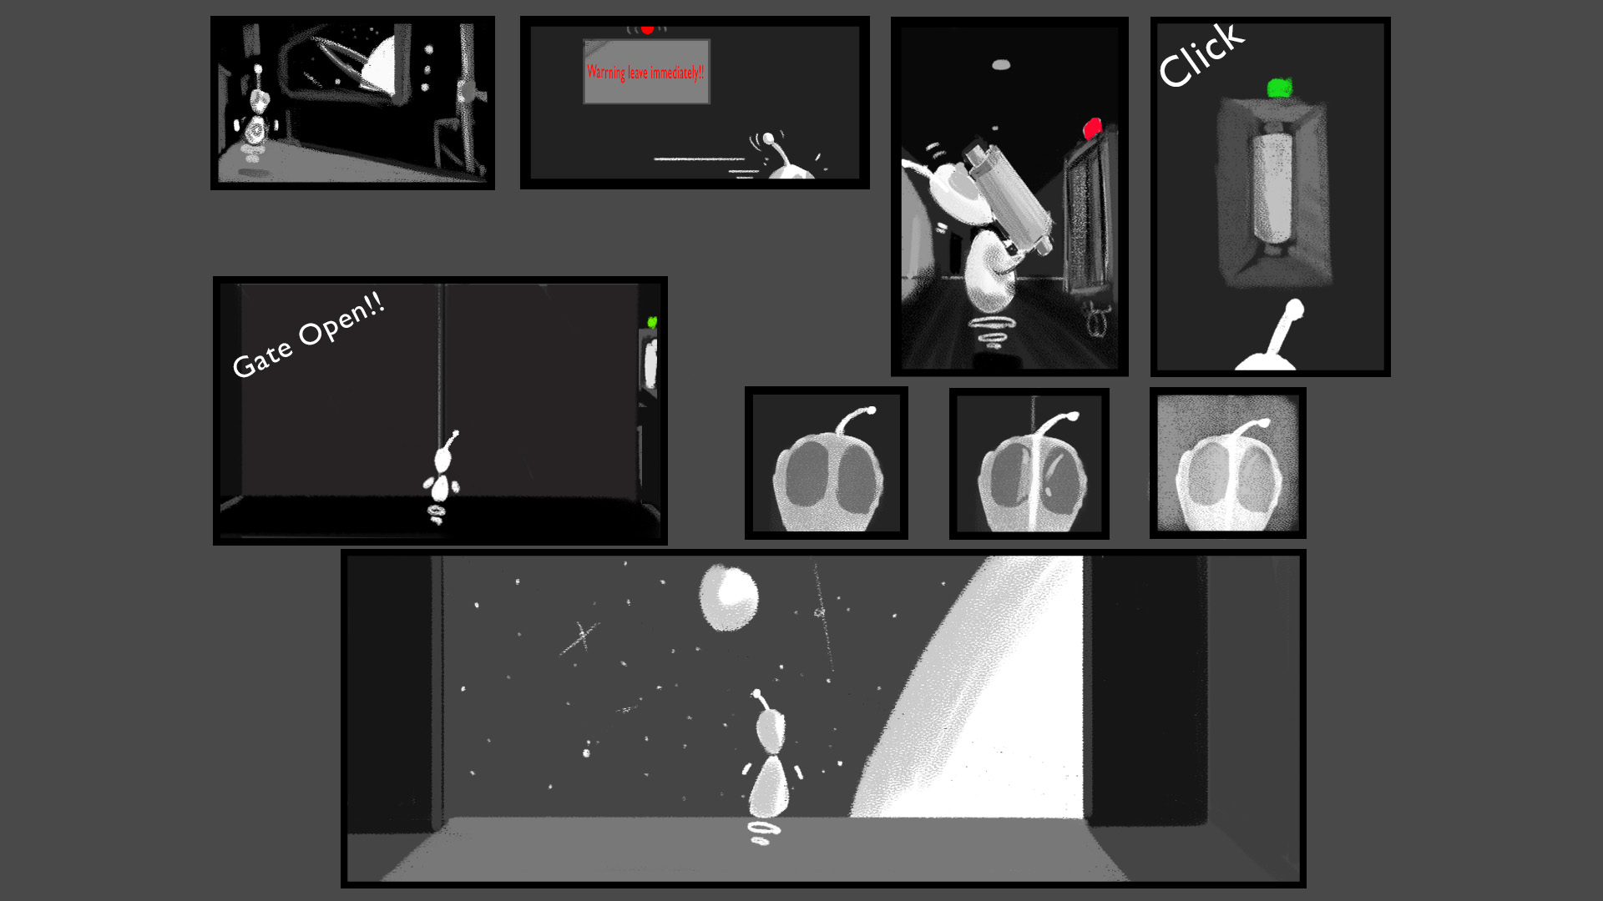
Concept art (6)
UI Sketches to final

Slide 19
Concept art (6)
UI Sketches to final

Slide 20
Concept art (6)
UI Sketches to final

Slide 21
Concept art (6)
UI Sketches to final

Slide 22

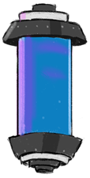

Sound Design
Sound effects & Music
Portal gun shoot
Title screen music
Battery pick up

Slide 23
Physics & Implementing game mechanics
A player can jump and move (WASD), and shoot portals by using right and left click mouse.
The game goal is to get out of the broken spaceship by using portals and collecting batteries.
Portal mechanics. A player has two portals. They are connected to each other. Everything that goes to the first portal, like the main character or a laser, comes out from the second portal immediately.
Can be opened only one type of each portal at the same time.
A player can walk on lasers.
A laser can open a door by powering a button.
There are the spawn points. To restart a level, press “F”.
To reset all portals, press “R”.

Slide 24

Testing Feedback
Ball/box removed.
Story changed.
Score system needed.
To change the colour of the laser from red to blue.
Remove portals by pressing “R”.
To build edges everywhere, where it is possible to put portals.
Make a sprite for respawn and a mechanic for that.
Create a trajectory sprite, which goes between a button and a door.
Create one more sound for the door.
Instructions in the beginning (a text or a frame), instead of self-exploring.
Create Bad and Good endings.
Balance level design.
Teach people to use mechanics step by step.
Create two cursors, where one shows closed and opened portals in the game.

Slide 25
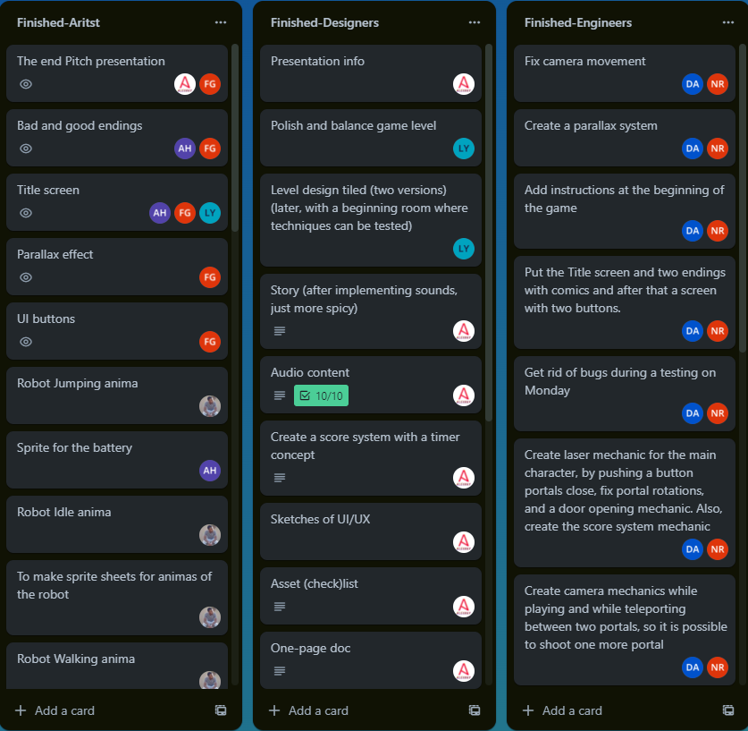
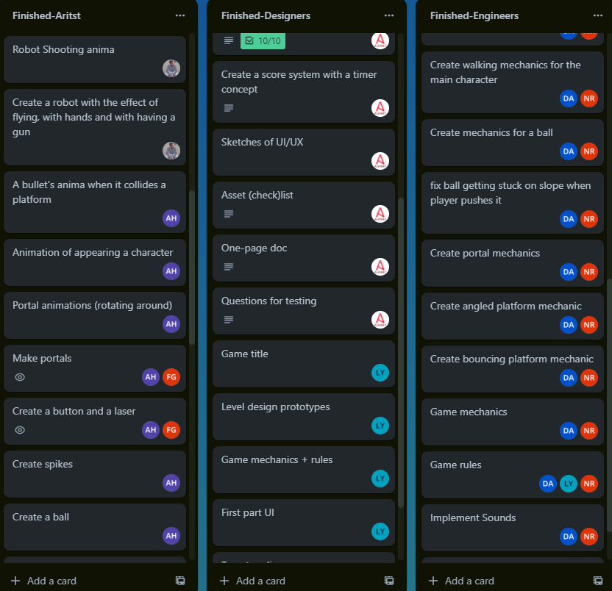
Hours & Tasks Planning

Slide 26
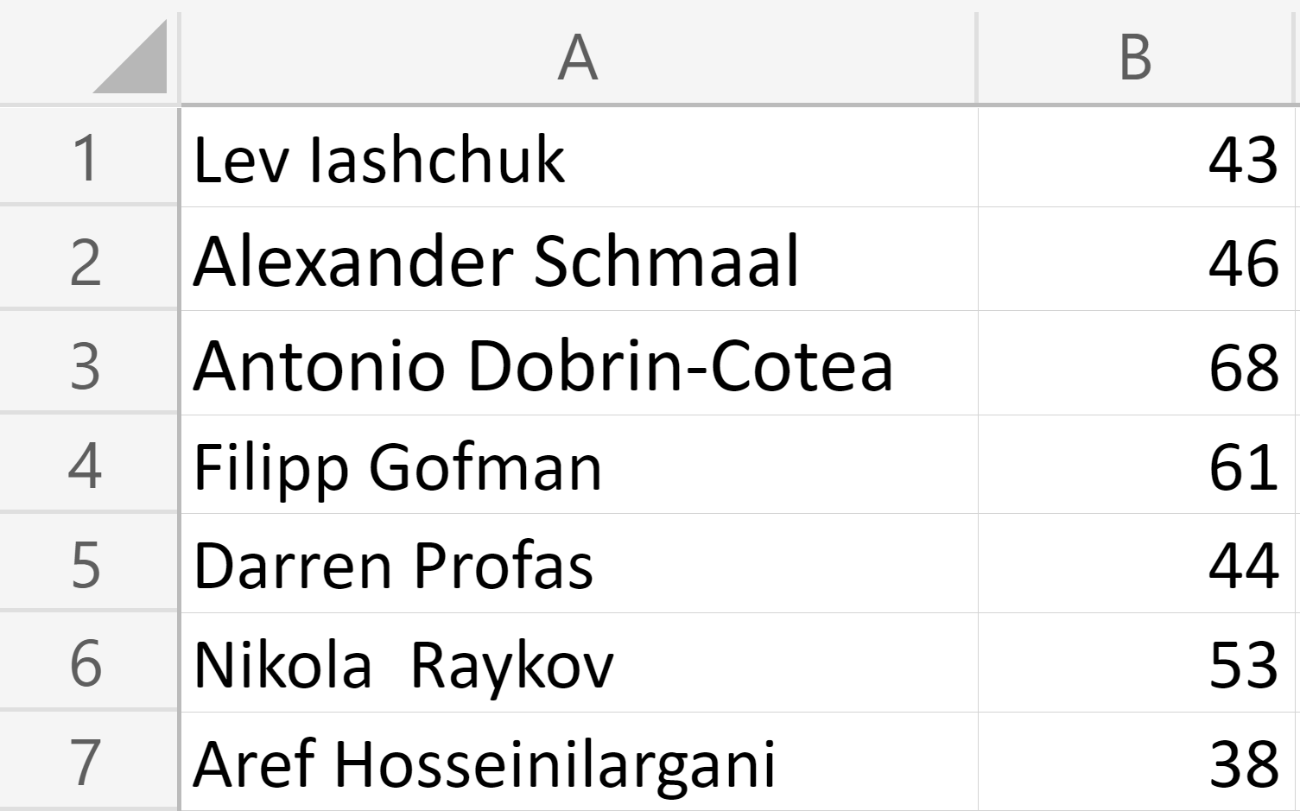
Hours & Tasks Planning

Slide 27
Reflection
What did go well?
Communication, distribution of tasks, respectful attitude,
working atmosphere,
solving problems, responsibility, new skills, and attending meetings and classes.
What did go badly?
Issues with GxP engine
FOR THE FUTURE
Better optimization
(to use Unity)

Slide 28
Thank you for listening!

Slide 29
Now, we would like to invite you to ask questions!

